Slide 1
Anesthetic management of gastric surgery
MERON A.
MAY, 2023/24

Slide 2
Contents
Physiology of the Stomach
Peptic ulcer disease
Gastric cancer surgery
Gastric hemorrhage

Slide 3
Stomach
  A J-shaped organ of digestion
  Stores and processes food for absorption.
  Associated with secretion and digestion

Slide 4
Gastric secretions
-Daily stomach secretion approximates 2 L with pH range b/n 1 and 3.5
-The major secretions are HCl, pepsinogen, intrinsic factor, and mucus.
-The gastric epithelium is under constant assault by a series of endogenous and exogenous factors.
-Gastric secretions occurs both under basal and stimulated conditions
Phases of gastric secretions
  Cephalic phase - The taste or smell of food, tactile sensations of food in the mouth
  Gastric phase - Distention of the stomach activates a parasympathetic reflex
  Intestinal phase - Chyme in the duodenum with a pH less than 2 or containing lipids inhibits gastric secretions
Notes:
In addition, a steady flow of exogenous substances such as medications, alcohol, and bacteria encounter the gastric mucosa
Basal acid production occurs in a circadian pattern, with highest levels occurring during the night and lowest levels during the morning hours. Cholinergic input via the vagus nerve and histaminergic input from local gastric sources are the principal contributors to basal acid secretion. Stimulated gastric acid secretion occurs primarily in three phases based on the site where the signal originates (cephalic, gastric, and intestinal).
Cephalic phase-The taste or smell of food, tactile sensations of food in the mouth, or thoughts of food stimulate the medulla oblongata.
Parasympathetic action potentials are carried by the vagus nerves to the stomach.
Preganglionic parasympathetic vagus nerve fibers stimulate postganglionic neurons in the enteric plexus of the stomach.
Postganglionic neurons stimulate secretion by parietal and chief cells (HCl and pepsin) and stimulate the secretion of the hormone gastrin.
Gastrin is carried through the circulation back to the stomach where it stimulates further secretion of HCl and pepsin.
Gastric phase-Distention of the stomach activates a parasympathetic reflex. Action potentials are carried by the vagus nerves to the medulla oblongata.
Medulla oblongata stimulates further secretions of the stomach. Distention also stimulates local reflexes that amplify stomach secretions.
Intestinal phase-Chyme in the duodenum with a pH less than 2 or containing lipids inhibits gastric secretions by three mechanisms
1. Sensory input to the medulla from the duodenum inhibits the motor input from the medulla to the stomach. Stops secretion of pepsin and HCl.
2. Local reflexes inhibit gastric secretion
3. Secretin, gastric inhibitory polypeptide, and cholecystokinin produced by the duodenum inhibit gastric secretions in the stomach

Slide 5
Different cell types secrete a specific secretions
  Parietal cells – secrete HCL
  Chief cell – Pepsin, proteolytic enzayme
  G cell – secrete Gastrin
  Goblet cell – mucus secretion
Notes:
Cells distributed preferentially along specific functional (glandular zone of stomach)

Slide 6
Peptic ulcer disease
Definition
  A problem of GIT characterized by mucosal damage secondary to gastric secretions(HCl and pepsin) and extrinsic erosives.
  Burning epigastric pain exacerbated by fasting and improved with meals is a symptom complex associated with peptic ulcer disease
  A defect in the gastric or duodenal wall that extends through the muscularis mucosa into the deeper layers of the wall (submucosa or the muscularis)
Notes:
Ulcers are defined as breaks in the mucosal surface >5 mm in size, with depth to the submucosa.
Disruption of the mucosal integrity of the stomach and/or duodenum leading to a local defect or excavation due to active inflammation

Slide 7
Can be acute or chronic based on extent and duration of injury
Acute:
  Associated with minimal inflammation and superficial erosion.
  Short duration and resolves quickly when causes identified and removed
Chronic:
  Long duration eroding through the muscular wall with the formation of fibrous tissue
  It may be present continuously for many months or intermittently throughout the person’s life time

Slide 8
Gastric mucosal defense:
A highly intricate biologic system is in place to provide defense from mucosal injury and to repair any injury that may occur.
  Mucus-bicarbonate-phospholipid layer as a physicochemical barrier to multiple molecules, including hydrogen ions.
  The mucous gel functions as a layer impeding diffusion of ions and molecules such as pepsin.
Notes:
Mucus is secreted in a regulated fashion by gastroduodenal surface epithelial cells. It consists primarily of water (95%) and a mixture of phospholipids and glycoproteins (mucin).

Slide 9
  Surface epithelial cells through several factors, including mucus production, epithelial cell ionic transporters that maintain intracellular pH and bicarbonate production.
  Prostaglandins in the gastric mucosa play a central role in gastric epithelial defense/ repair
    Regulate the release of mucosal bicarbonate and mucus,
    Inhibit parietal cell secretion, and
    Maintain mucosal blood flow and epithelial cell restitution.
Notes:
Prostaglandins are derived from esterified arachidonic acid, which is formed from phospholipids (cell membrane) by the action of phospholipase A2. A key enzyme that controls the rate-limiting step in prostaglandin synthesis is cyclooxygenase (COX), which is present in two isoforms (COX-1, COX-2), each having distinct characteristics regarding structure, tissue distribution, and expression. COX-1 is expressed in a host of tissues, including the stomach, platelets, kidneys, and endothelial cells. This isoform is expressed in a constitutive manner and plays an important role in maintaining the integrity of renal function, platelet aggregation, and gastrointestinal (GI) mucosal integrity. In contrast, the expression of COX-2 is inducible by inflammatory stimuli, and it is expressed in macrophages, leukocytes, fibroblasts, and synovial cells. The beneficial effects of nonsteroidal anti-inflammatory drugs (NSAIDs) on tissue inflammation are due to inhibition of COX-2; the toxicity of these drugs (e.g., GI mucosal ulceration and renal dysfunction) is related to inhibition of the COX-1 isoform. The highly COX-2–selective NSAIDs have the potential to provide the beneficial effect of decreasing tissue inflammation while minimizing toxicity in the GI tract. Selective COX-2 inhibitors have had adverse effects on the cardiovascular (CV) system, leading to increased risk of myocardial infarction. Therefore, the U.S. Food and Drug Administration (FDA) has removed two of these agents (valdecoxib and rofecoxib) from the market

Slide 10
Pathophysiology
The gastro-duodenal mucosal integrity depends on the balance between “hostile” factors and “protective” factors such as prostaglandins, mucus, bicarbonate, and mucosal blood flow.
PUD is a result of acid/pepsin production imbalance with protective mechanisms such as mucous production
  A symptom complex initiates when mucosal protective capacity overwhelmed by hostile factors
HCl and pepsinogen are the two principal gastric secretory products capable of inducing mucosal injury
Notes:
“hostile” factors such as gastric acid, H. pylori, NSAIDs and pepsin
“protective” factors such as prostaglandins, mucus, bicarbonate, and mucosal blood flow.

Slide 11
H pylori infection
  Infection with the bacterium H. pylori accounts for the majority of PUD
  Accounts for about 90% of DU and 70% of gastric ulcer
  Majority of induced increase in acid secretion are due to direct effect of H pylori infection
  Acute infection leads to decreased secretion
  Release of inflammatory mediators (cytokines ) on G and Parietal cells
  Associated decrease in duodenal mucosal bicarbonate production
PUD encompasses both gastric and duodenal ulcers.

Slide 12
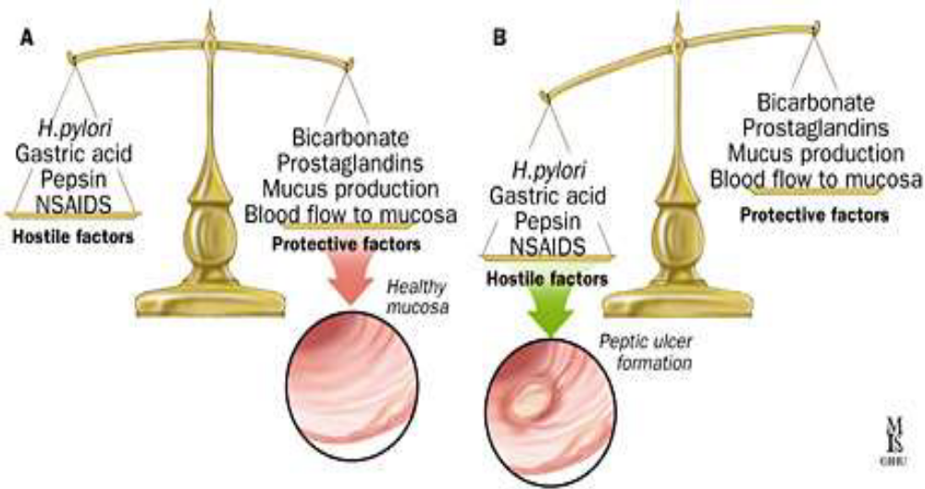
Fig. The way to peptic ulceration

Slide 13
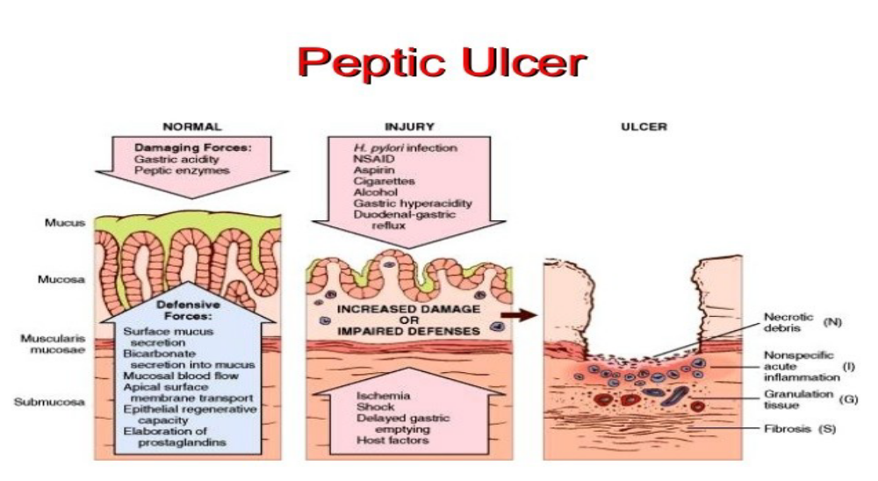

Slide 14
Features of gastric and duodenal ulcers
Duodenal ulcers
  Can occur at any age (30-40s)
  M=F
  H pylori accounts almost all (90%)
  High acid secretion
  Aggravated by fasting
  No vomiting
  Awakens the pt at night time
  No weight loss?
Gastric ulcer
  Occurs late in life(50-60s)
  M:F=2:1
  High likelhood of being silent
  H pylori accounts for ≈70%
  Low to normal acid secretion
  Aggravated by feeding
  Vomiting is common
  Weight loss?

Slide 15
Causes/risk factors
  H pylori infection
  NSAIDS
  Gastric acids
  Stress
  Smoking
  Alcohol
  Other medications (steroids, calcium infusion, KCl, antiplatelets, chemotherapeutics ( I.V fluorouracil)
  Malignancies etc. …

Slide 16
Clinical features
  It is now clear that >90% patients with this symptom complex (dyspepsia) do not have ulcers that the majority of patients with peptic ulcers may be asymptomatic.
Episodic gnawing , aching or burning epigastric pain
  Worsened by an empty stomach or after meal
  Common during night time
Indigestion (dyspepsia), early satiety, bloating, vomiting, hematemesis, melena, loss of appetite, intolerance of fatty foods, heartburn, weight loss,….
Notes:
pain occurring two to five hours after meals or on an empty stomach; and nocturnal pain relieved by food intake, antacids, or antisecretory agents.
A history of episodic or epigastric pain, relief of pain after food intake, and nighttime awakening because of pain with relief following food intake are the most specific findings for peptic ulcer and help rule in the diagnosis.

Slide 17
Diagnosis
Usually based on clinical features and specific testing
Radiologic tests ,i.e. barium x ray
Laboratory tests
  Serum gastrin and calcium
  Gastric acid analysis
  Urea breath tests
  Serology (ELISA antibody test)
Endoscope –to visualize and biopsy taking
Notes:
hyperparathyroidism causes increased serum calcium levels which leads to increased serum levels of gastrin and acetylcholine. These changes result in stimulation of gastric acid secretion and peptic ulcer disease.

Slide 18
Treatments
Goals of treatment
  Promotion of ulcer healing.
  Relief symptom of pain.
  Prevention of recurrence (relapse).
  Prevention of complications
General measure
  Rest
  Diet modifications
  Avoid aggravating factors
Notes:
Treatment of peptic ulcer disease should include eradication of H. pylori in patients with this infection. The recommended duration of therapynfor eradication is 10 to 14 days; however, shorter treatment Potential benefits of shorter regimens include better compliance, fewer adverse effects, and lower costs. courses (regimens of one, five, and seven days) are

Slide 19
Medical therapy
  Reduce gastric acidity
  Prevent acids and pepsin from penetrating to the ulcer base,
  Provide a prostaglandin analog,
  Remove environmental factors such as NSAIDs and smoking

Slide 20
Anti acids, H2 blockers and PPIs
Misoprostol(prostaglandin analog)
“Triple therapy” a gold standard for H pylori treatment.
  For better eradication of H pylori(decrease recurrence rate)
  Omeprazol or lansoprazol plus amoxillin / clarithromycin BID.
Notes:
Sulfated disaccharides (sucralfate)

Slide 21
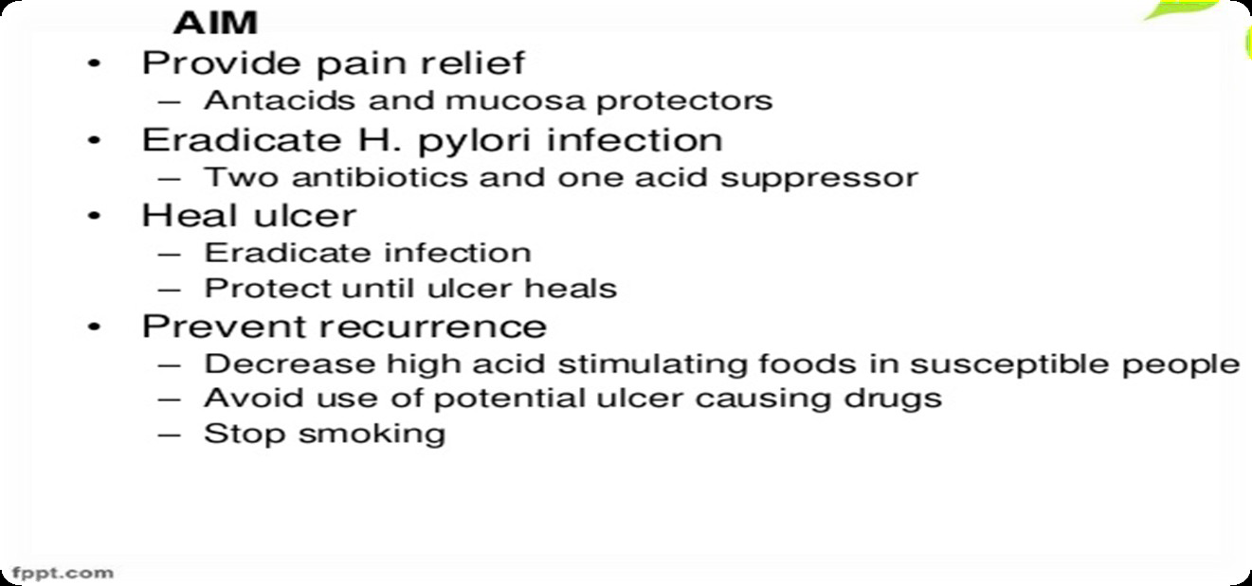
General aim of medical therapy

Slide 22
Complications
  Hemorrhage
  Perforation
  Obstruction
Notes:
About 25 percent of patients with peptic ulcer disease have a serious complication such as hemorrhage, perforation,
or gastric outlet obstruction. Silent ulcers and complications are more common in older patients and in patients taking NSAIDs.16,17 The incidence of serious upper gastrointestinal complications among persons in the general population who do not take NSAIDs is extremely low (less than one per 1,000 person-years).
bleeding
Upper gastrointestinal bleeding occurs in 15 to 20 percent of patients with peptic ulcer disease. It is the most common cause of death and the most common indication for surgery in the disease. In older persons, 20 percent of bleeding episodes result from asymptomatic ulcers.17 Patients may present with hematemesis (bright red or “coffee ground”), melena, fatigue caused by anemia, orthostasis, or syncope. There are several risk-stratification schemes that can help physicians determine the need for urgent intervention and predict continued or recurrent bleeding after endoscopic therapy.
In stable patients with gastrointestinal bleeding, potentially ulcerogenic medications should be discontinued. A proton pump inhibitor should be administered intravenously; this reduces transfusion requirements, need for surgery, and duration of hospitalization.
Patients whose condition is unstable should undergo fluid or packed-cell resuscitation followed by emergent EGD and coagulation of bleeding sites through endoscopic ligation; placement of hemoclips; injection of epinephrine, alcohol, or a sclerosant; or a combination of methods.33 Oral antisecretory therapy should be initiated as soon as patients resume oral intake. Treatment of H. pylori infection is more effective than antisecretory therapy without eradication of H. pylori for preventing recurrent bleeding. Therefore, patients with bleeding peptic ulcers should be tested for H. pylori infection and should be prescribed eradication therapy if results are positive. If continued administration of aspirin or NSAIDs is required, concurrent administration of misoprostol or a proton pump inhibitor should be considered.
perforation
Perforation occurs in approximately 2 to 10 percent of peptic ulcers.25 It usually involves the anterior wall of the duodenum (60 percent), although it may also occur in antral (20 percent) and lesser-curve (20 percent) gastric ulcers. Perforation of ulcers in children is rare. Free peritoneal perforation and resulting chemical and bacterial peritonitis is a surgical emergency causing sudden, rapidly spreading, severe upper abdominal pain exacerbated by movement; the pain may radiate to the right lower abdomen or to both shoulders. Fever, hypotension, and oliguria suggest sepsis and circulatory compromise. Generalized abdominal tenderness, rebound tenderness, board-like abdominal wall rigidity, and hypoactive bowel sounds (clinical signs of peritonitis) may be masked in older patients and those taking steroids, immunosuppressants, or narcotic analgesics. Upright or lateral decubitus abdominal radiography or erect chest radiography may demonstrate pneumoperitoneum; however, the absence of this finding does not rule out perforation.17 Sonography, computed tomography, and gastroduodenography are confirmatory. Initial resuscitation with large-volume crystalloids; nasogastric suction; and administration of intravenous broad spectrum antibiotics.
Perforated gastric ulcers are treated with an omental patch, wedge resection of the ulcer, or a partial gastrectomy and reanastomosis. Coexisting H. pylori infection should be eradicated to reduce recurrence and minimize the need for long-term antisecretory therapy and further surgical intervention.25,37 In older patients, mortality rates from perforation and its management may be as high as 30 to 50 percent.
gastric outlet obstruction
Peptic ulcer disease is the underlying cause in less than 5 to 8 percent of patients presenting with gastric outlet obstruction. Patients with recurrent duodenal or pyloric channel ulcers may develop pyloric stenosis as a result of acute inflammation, spasm, edema, or scarring and fibrosis. Symptoms suggesting obstruction include recurrent episodes of emesis with large volumes of vomit containing undigested food; persistent bloating or fullness after eating; and early satiety. Weight loss, dehydration, and a hypochloremic, hypokalemic metabolic alkalosis may result; a tympanitic epigastric mass representing the dilated stomach with visible gastric peristalsis also may be observed. EGD or gastroduodenography (using diatrizoate meglumine and diatrizoate sodium [Gastrografin] or barium) is recommended to determine the site, cause, and degree of obstruction. Malignancy, a more common cause of obstruction (responsible for more than 50 percent of cases), should be ruled out.38 Obstruction resulting from acute inflammation or edema responds well to nasogastric decompression, administration of H2 blockers or proton pump inhibitors, and eradication of H. pylori. Prokinetic agents should be avoided. Endoscopic pyloric balloon dilatation or surgery (vagotomy and pyloroplasty, antrectomy, or gastroenterostomy) are options to relieve chronic obstruction

Slide 23
Hemorrhage
  Most common cause of death and indication of surgery in PUD
  Patients may present with hematemesis (bright red or “coffee ground”), melena, fatigue caused by anemia, orthostasis, or syncope.
  Stable patients benefit from continuing PPIs
  Unstable patients should undergo aggressive resuscitation followed by emergent endoscope and coagulate bleeding sites

Slide 24
Perforation
  2-10% of ulcers
  Perforation resulting chemical and bacterial peritonitis is a surgical emergency causing sudden, rapidly spreading, severe upper abdominal pain exacerbated by movement
  Perforated gastric ulcers are treated with an omental patch, wedge resection of the ulcer, or a partial gastrectomy and reanastomosis.
  May be suggested by sepsis and circulatory shock

Slide 25
Gastric outlet obstruction
  Occurs in less than 8% PUD.
  Recurrent episodes of emesis with large volumes of vomit containing undigested food; persistent bloating or fullness after eating; and early satiety.
  Weight loss, dehydration, and a hypochloremic, hypokalemic metabolic alkalosis may result

Slide 26
Surgical therapy
  Declined now a days, because of more recent treatment regimens
  But patient who were intolerant of medications or less compliant with medication regimens and high risk of complications would benefit from surgery
  Surgery is also requested in disease intractable to medical therapy and obstructing ulcers.
  (patients dependent on steroids or NSAIDs)
Notes:
Surgery is indicated in patients who are intolerant of medications or do not comply with medication regimes, and those at high risk of complications (e.g., transplant recipients, patients dependent on steroids or NSAIDs, those with giant gastric or duodenal ulcer, those with ulcers that fail to heal with adequate treatment). Surgery should also be considered for patients who have a relapse during maintenance treatment or who have had multiple courses of medications.

Slide 27
Principles of surgery for PUD
To Terminate vagal nerve supply to oxyntic glands via truncal vagotomy and drainage (pyloroplasty to drain the stomach)
To spare hepatic and coeliac vagus branches but removing to secretory cells via selective vagotomy
Highly selective vagotomy denervating only acid producing glands I,e does not require drainage
Bilroth I- partial gastrectomy (end to end) for gastric ulcer
To cover the perforation with interrupted sutures and piece of omentum (graham’s patch).

Slide 28
Anesthetic management
Patients present for the surgery with complicated ulcer diseases
Major anesthetic challenges
  Hemodynamically unstable patient
  Anemia (preop, Hgb &Hct)
  Full stomach (aspiration risk)
  Electrolyte and acid base imbalances
  Enzyme inhibition(ulcer medications)
The patient with gastric disease or upper GI bleeding is often at risk for pulmonary aspiration, and the trachea should be intubated with the patient awake or after rapid-sequence induction with cricoid pressure .

Slide 29
Hemodynamic status should be sought and adequate resuscitation and anesthetic dose adjustments should be considered in a clinically hypovolemic patients
Gastric decompression with large bore OG tube before anesthetic induction in case of complicated ulcer diseases
Balanced anesthesia with inhalational agents and propofol infusion, and opiates with a desired muscle relaxation
Pain management protocols

Slide 30
Combined epidural/general anesthesia to provide adequate pain control with good surgical condition
Treat hypotension with fluids and vasopressors and bradycardia with anticholinergics.
Notes:
What do you think with the anticholinesterases?

Slide 31
The decision to extubate at the end of surgery depends on the patient's underlying cardiopulmonary status and extent of the surgical procedure.
Patient should be hemodynamically stable, normothermic, alert, cooperative, and fully reversed from any muscle relaxants and without pulmonary compromise before extubation.

Slide 32
Complications
Late
• Diarrhoea
• Enterogastric reflux
• Recurrent ulceration
• Iron deficiency anaemia
• Risk of colorectal and gastric tumours
• Weight loss
• Megaloblastic anaemia
• Osteomalacia
• Anastomotic ulcer
• Gastro-jejunocolic fistula
Immediate
  • Bleeding
  • Gastric retention
  • Dysphagia
  • Obstruction
  • Acute pancreatitis
Notes:
Dumping syndrome

Slide 33
Postoperatively
Pain control
    Epidural infusion
      Opoid combined with LAs safe
    PCA ( NSAIDs?)
Careful while prescribing
  ASA
  Clopidogrel
  Chemotherapeutics

Slide 34
Thank you

Slide 35


Slide 36
Contents
Introduction
Pathogenesis of gastric cancer
Etiologies and risk factors
Clinical features
Treatment
Anesthesia for surgery of gastric cancer

Slide 37
Discussion point
What is cancer? And its pathogenesis
What are treatment options for cancer?
What are complications of cancer treatments?
Notes:
Cancer results from an accumulation of genetic mutations that causes dysregulation of cellular proliferation. Genes are involved in carcinogenesis by virtue of inherited traits that predispose to cancer (e.g., altered metabolism of potentially carcinogenic compounds), mutation of a normal gene into an oncogene that promotes the conversion of normal cells into cancer cells, or inactivation of a tumor suppressor gene that allows a tumor to undergo malignant transformation. A critical gene related to cancer in humans is the tumor suppressor p53. This gene is not only essential for cell viability but critical for monitoring damage to DNA. Inactivation of p53 is an early
step in the development of many types of cancer. Stimulation of oncogene formation by carcinogens (tobacco, alcohol, sunlight) is estimated to be responsible for 80% of cancers in the United States. Tobacco accounts for more cases of cancer than all other known carcinogens combined.
The fundamental event that causes cells to become malignant is an alteration in their DNA structure. These mutations occur in cells of target tissues, and these cells then become the ancestors of the entire future tumor cell population. Evolution to more undiﬀerentiated cells reﬂects high mutation rates and contributes to the development of tumors that are resistant to therapy.
Cancer cells must evade the host’s immune surveillance system, which is designed to seek out and destroy tumor cells. Most mutant cancer cells stimulate the host’s immune system to form antibodies.

Slide 38
Introduction
Gastric cancer is the 4th most common malignancy and 2nd most common cause of global cancer mortality
Gastric adenocarcinoma (95%), lymphoma (4%), leiomyosarcoma (1%)
Adenocarcinomas are most often found in the gastric cardia (31%), followed by the antrum (26%), and body of the stomach (14%).
Rarely from carcinoid, angiosarcoma, SCC, metastatic (colon, pancreas, breast,…
Notes:
The incidence shows wide geographical variation. More than 50% of the new cases occur in developing countries.

Slide 39
Pathology
Can be of two types based on pathological variants
1. The intestinal-type:
  Is the end-result of an inflammatory process that progresses from chronic gastritis to atrophic gastritis and finally to intestinal metaplasia and dysplasia
  Cohesive neoplastic cells forming gland – like tubular structures
  Frequently ulcerative
  More commonly in antrum - prepylorus, cardia - fundus and lesser curvature of stomach, and often preceded by prolonged pre - cancerous process
  Is more common among elderly men

Slide 40
2. The diffuse-type,
  Develops throughout stomach, including cardia and associated with development of linitis plastic or leather bottle appearance
  Unfavorable prognosis because the diagnosis is often delayed until the disease is quite advanced.
  Cell cohesion absent, with individual cells infiltrating and thickening stomach wall without forming a discrete mass.
  Gastric H. pylori infection is highly associated with this type as with the intestinal-type.
  More prevalent among women and in individuals under the age of 50.
Notes:
Over 90% of gastric tumors are adenocarcinomas arising from dysplasia in the lining of the gastric mucosa and typically present late in their natural history.
The remaining 10% of tumors are malignant lymphomas or smooth muscle tumors.
including cardiac → loss of distensibility of gastric wall (“linitis plastica” or "leather bottle“ appearance), with a far more ominous prognosis

Slide 41
Early versus advanced gastric cancer
EARLY GASTRIC CA
ADVANCED GASTRIC CA
Confined to mucosa or submucosa regardless of LN involvement
A gradual increase in incidence due to advanced instruments
A subtle lesion of <2cm diameter
Lower two-thirds of the stomach is the most common site
Amenable to endoscope and better prognosis
Aggressive, large, and diffuse late presenting tumors
Exhibit early submucosal invasion, extend into the esophagus, and are spread readily by the lymphatic system.
Particularly common at the esophagogastric junction
Carries a poor prognosis

Slide 42
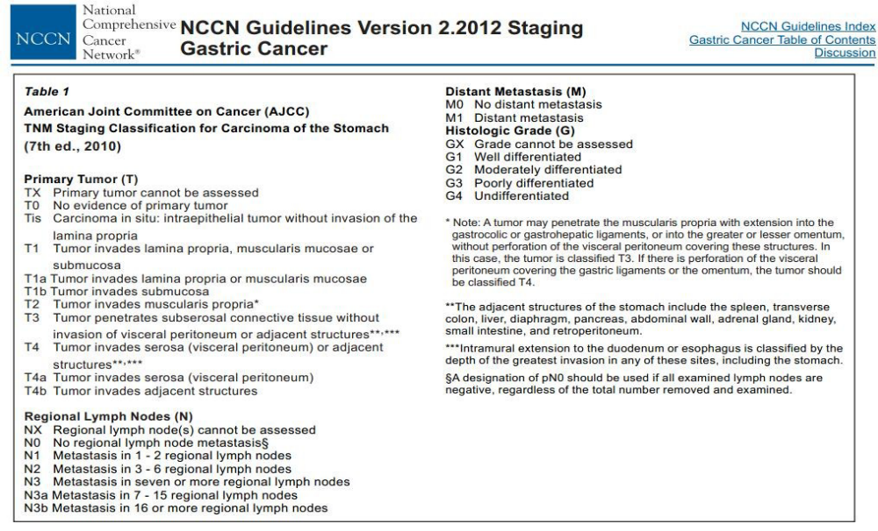

Slide 43
Advanced TNM stages are associated with worse prognoses
Worse prognoses are associated with tumors of the cardia, shorter duration of symptoms prior to diagnosis, tumor unresectability, and poorly differentiated histology.

Slide 44
Etiologies and risk factors
Age
Environment
Occupation
Socioeconomic status
Familial
H pylori
Blood group A
Obesity
Diet
Previous gastric surgery
Stomach ulcer
Smoking
Alcoholism

Slide 45
Clinical features
Early gastric cancer is usually asymptomatic but may be discovered during endoscopy for investigation of dyspepsia.
Advanced disease – indigestion, nausea, dysphagia, early satiety, anorexia /loss of appetite, weight loss….
Weight loss, nausea & vomiting – tumors of pylorus
Dysphagia & early satiety – diffuse lesions originating in cardia
Hematemesis, melena, anemia, jaundice, ascites…

Slide 46
Physical examination
  Provides a clue to diagnose gastric cancer
  The patient may appear completely healthy on physical exam.
  Abdominal mass, liver metastases, gastric distention,
  Supraclavicular adenopathy (Virchow’s node), rectal mass (Blumer’s shelf), enlarged ovary (Krukenberg’s syndrome), or umbilical metastases (Sister Mary Joseph’s node).
  Muscle weakness, splenomegaly, ascites, obstructive jaundice, and peritoneal carcinomatosis may be noted in more advanced disease.

Slide 47
DX:
  Based on history and physical examination
  Upper GI endoscopy is most accurate
  Diagnostic laparoscopy
  Abdominal CT scan

Slide 48
Treatment
Chemotherapy
Radiotherapy
Surgery
Notes:
Once a patient has been diagnosed with a potentially curable (stages I–III) gastric adenocarcinoma, they should proceed to have perioperative chemotherapy and a gastrectomy with lymph node clearance.

Slide 49
Chemotherapy
An essential adjuvant treatment reserved for non operable tumors
Fluorouracil (5-FU) is the most commonly used drug in the treatment of gastric cancer
Gastric cancer may respond well to combination cytotoxic chemotherapy and neoadjuvant chemotherapy with improved outcome following surgery.
In operable tumours, patients should receive chemotherapy before surgery with regimen of combination of epirubicin, cisplatinum, and 5-fluorouracil

Slide 50
In inoperable tumors or patients with advanced disease, chemotherapy is considered palliative.
The patients receive a first line chemotherapy including the same regimen as in operable tumors
Second line therapy continues using combinations that include taxotere are increasingly being used.
Notes:
The chemotherapy involved three preoperative and three postoperative cycles of epirubicin, cisplatin, and fluorouracil (ECF). The primary endpoint was overall survival. The 5 yr survival rate was 36% and 23% for the perioperative chemotherapy group and the surgery group, respectively
Given this evidence, perioperative chemotherapy is now an essential adjuvant treatment. ECF has an acceptable side-effect profile, but is not without risk. Anaesthetists need to be aware of these, given that most patients will have received chemotherapy before their major surgery. Epirubicin is known to cause cardiac toxicity, particularly when given above doses of 200 mg m22 (impaired systolic LV function).
Cisplatin ismknown to cause nephrotoxicity; Nearly every patient given ECF chemotherapy suffers haematological side-effects; thrombocytopenia is the most common.
First-Line Therapy :Two-drug cytotoxic regimens are preferred because of lower toxicity.
Preferred Regimens: Fluoropyrimidine (fluorouracil † or capecitabine) and cisplatin2-5 (category 1) , Fluoropyrimidine (fluorouracil † or capecitabine) and oxaliplatin
Second-Line: Therapy Dependent on prior therapy and PS: • Preferred Regimens: Ramucirumab and paclitaxel (category 1)26 Docetaxel (category 1)15,16 Paclitaxel (category 1)17,18,27 Irinotecan (category 1)27-30 Ramucirumab (category 1

Slide 51
Anaesthetists need to be aware of these,
-most patients have received chemotherapy before their major surgery.
- Epirubicin is known to cause cardiac toxicity, particularly when given above doses of 200 mg m22 (impaired systolic LV function).
-Cisplatin is known to cause nephrotoxicity;
-Nearly every patient given fluorouracil Chemotherapy suffers haematological side-effects; thrombocytopenia is the most common.

Slide 52
Systemic toxicity | Chemotherapeutics
Pulmonary toxicity | Methotrexate, bleomycin, busulphan, cyclophosphamide, cytarabine, carmustine
Cardiac toxicity | Busulphan, cisplatin, cyclophosphamide, daunorubucin, 5-fluorouracil
Renal toxicity | Methotrexate, L-asparginase, carboplatin, ifosfamide, mitomycin-C
Hepatic toxicity | Actinomycin D, methotrexate, androgens, L-asparginase, busulphan, cisplatinum
CNS toxicity | Methotrexate, cisplatin, interferon, hydroxyurea, procarbazine, vincristine
Hematologic system | Epirubicin, Cisplatin, flourouracil
SIADH secretion | Cyclophosphamide, vincristine

Slide 53
Radiotherapy
Allows high dose of radiation to tumour bed or residual disease while permitting the exclusion of mobile radiosensitive normal tissues from the area irradiated.
RT alone has not proved useful in treating gastric cancer.
Appears to improve survival when combined with chemotherapy in unresectable tumor

Slide 54
Radiotherapy toxicity
Cardiovascular | Pulmonary | Head and neck | Other system
Arrhythmias Pericarditis Pericardial effusion Prolonged QT interval Coronary artery disease | Pulmonary edema Pneumonitis Pulmonary fibrosis | Mucositis Dry mouth Altered taste Dermatitis Osteonecrosis Trismus Dysphagia Changes in airway | Hypothyroidism

Slide 55
Surgery for gastric cancer
  The surgical approach to gastric cancer is dictated by the site and extent of the tumor, the patient’s age, and physical status.
The surgical options include a subtotal or total gastrectomy, with first and second compartment lymph node clearance.
If the tumor has breached the submucosa, there may be extensive lateral spread requiring more radical surgery, such as splenectomy, distal pancreatectomy, and extended wide resection
Communication is vital-especially in this group the surgery may be palliative in nature
Notes:
Previously, a radical gastrectomy involved a total gastrectomy, lymphadenectomy, splenectomy, and excision of the distal pancreas. This procedure carried significant morbidity and mortality.
Current guidelines state that the distal pancreas should not be removed unless there is direct invasion and is a potentially curative procedure.
A splenectomy has an adverse effect on prognosis and is not recommended for tumours in the distal two-thirds of the stomach. Splenectomy and splenic hilar node resection should only be considered for those with proximal tumours along the greater
curvature or posterior wall where splenic node involvement is likely.
There has been considerable controversy over the years regarding the extent of lymphadenopathy. D1 resection involves removal of
the perigastric lymph nodes and a D2 resection includes perigastric, coeliac, hepatic, and splenic nodes. Studies from specialist
centres suggest a survival benefit from a D2 lymphadenectomy;11 hence, this is the current recommendation.

Slide 56
For tumors of the distal-third of the stomach, a subtotal gastrectomy is usually performed. Approximately 80% of the stomach is resected along with the first part of the duodenum.
Middle-third cancers usually necessitate a total gastrectomy. For proximal-third cancers, which are often more advanced at surgery, a choice exists between a proximal subtotal or total gastrectomy.

Slide 57
Anesthesia for gastric cancer surgery
Cancer patients present numerous challenges for anesthetists
  Perioperative adverse events related to disease itself or problems related to treatment
  Most pts receive a multidrug therapy thus increased risk of toxicity profile
  Ex. Bleomycin (pul. Toxicity), doxorubicin (cardiotoxic), cyclophosphamide (nephrotoxic, electrolyte d/o, inhibits psuedocholinisterase), cisplatin (nephrotoxic), methotrexate/5-FU(renal and hepatic toxicity)

Slide 58
Postoperative mortality and morbidity after gastric cancer surgery depends to a large degree on the preoperative physiological status of the patient.
Any benefit derived from surgery will depend not only on the stage of the gastric disease but also on the fitness of the patient to withstand anesthesia and surgery

Slide 59
Preoperative assessment and preparation
Many patients are smokers and are likely to have multiple co-morbidities such as IHD, hypertension, and respiratory problems.
Assess the nutritional status, malnourished associated with increased perioperative morbidity and mortality
Most patients are taking chemotherapy that would have possibility of haematological, pulmonary, renal, and cardiac compromise
Notes:
Malnourished patients suffer more postoperative complications. The risk increases with a body mass index of ,18.5, 20% weight loss, body weight of ,90% of predicted, and hypoalbuminaemia
most patients will have received preoperative chemotherapy, with the possibility of haematological, renal, and cardiac compromise.

Slide 60
Patients presenting for gastric surgery generally comprise two groups:
  (1) those presenting for emergency surgery following GI bleeding or perforation, and
  (2) those presenting with gastric carcinoma or elective treatment of PUD.
Patients in the first group are often haemodynamically unstable and require rapid preop assessment and appropriate fluid resuscitation.
It is prudent to consider full-stomach precautions in both patient groups
Notes:
Bleeding is a frequent problem for patients with advanced cancer, with approximately 10% of all patients having at least one episode and almost 30% in patients with hematologic malignancies (1). These episodes may range from low-grade oozing to major episodic bleeding or even catastrophic bleeds. Bleeding can be caused by the cancer itself, as with local tumor invasion, abnormal tumor vasculature, or tumor regression. It may also be related to the anti-tumor treatments including prior radiation therapy or chemotherapy. It can be exacerbated by immunotherapies such as bevacizumab, nonsteroidal anti-inflammatories drugs (NSAIDs), and anticoagulants that are routinely used in cancer patients. Patients may also be predisposed to bleeding due to thrombocytopenia from the malignancy or induced by chemotherapy.
Anti-inflammatories are often used to treat pain for patients with advanced cancer, but it is important to consider their anti-platelet and anti-coagulant properties that may exacerbate bleeding. Similarly, patients with advanced cancer are often on anticoagulants such as warfarin or enoxaparin, which necessitates the considerations of the risks of further bleeding against the risks of deep venous or pulmonary thromboembolism. Among patients on anticoagulation, patients with cancer develop bleeding complications at a higher rate than those without cancer

Slide 61
Respiratory ; pulmonary function tests, and a chest X-ray in pulmonary abnormalities.
  Bleeding patients at risk for aspiration therefore in urgent need for airway protection.
CVS; decreased skin turgor, increased HR, decreased BP, decreased UOP due to severe hypovolemia
  Resuscitate and Correct hypovolemia before anesthesia
Patients with cardiorespiratory disease will also need evaluation of their pathology and reserve by means of an echo
Notes:
Preoperative
Patients presenting for gastric surgery generally comprise two groups: (1) those presenting for emergency surgery following GI bleeding or perforation, and (2) those presenting with gastric carcinoma or elective treatment of PUD (rare). Patients in the first group are often hemodynamically unstable and require rapid preop assessment and appropriate fluid resuscitation. It is prudent to consider full-stomach precautions in both patient groups (see p. B-4).
Respiratory Patients with GI bleeding are at ↑ risk for aspiration of blood and gastric contents. If this has occurred, patient may have significant respiratory insufficiency (in urgent need of tracheal intubation for “protection” of airway).
Tests: CXR; consider ABG Cardiovascular Hypovolemia may be severe due to N/V, diarrhea, poor po intake, peritonitis, or GI blood loss. Sx include ↓skin turgor, ↑HR, ↓BP, ↓UO. Correct hypovolemia before induction of anesthesia.
Tests: Orthostatic vital signs; ECG, if indicated from H&P. Renal GI fluid loss can lead to renal and electrolyte abnormalities.
Tests: Consider electrolytes; BUN; Cr. Hematologic Misleading ↑Hct 2° GI fluid loss may be present; patients with GI bleeding will likely be anemic and may have a coagulopathy. Correct coagulopathy and anemia before induction, if possible.
Tests: CBC with Plts, PT/PTT if coagulopathy suspected

Slide 62
Renal ; acute kidney failure, reduced RBF, Fluid and electrolyte abnormalities
Correct coagulopathy and anemia before induction, if possible.
Improve nutritional status prior to surgery, consult dietitian
Encourage the patient to stop smoking a day before surgery.

Slide 63
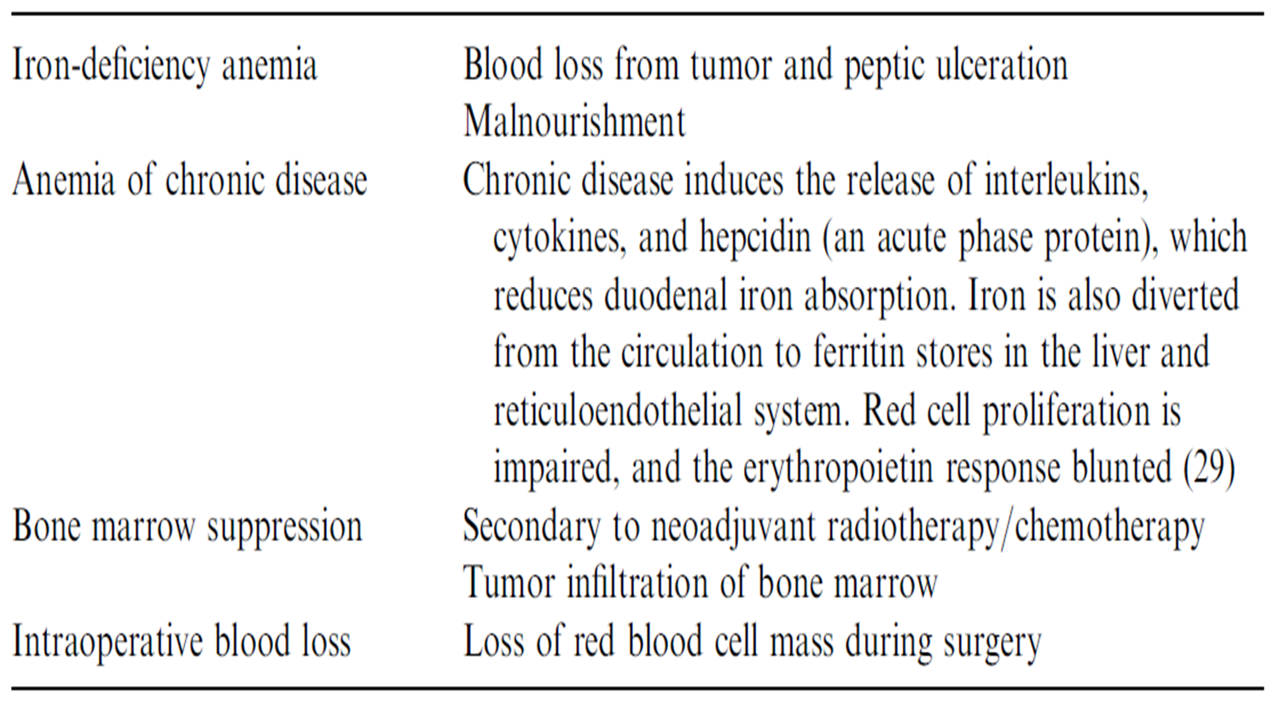
  Patients with gastric cancer can present with anemia of multifactorial etiology

Slide 64
Intraoperative
The usual anesthetic technique for gastric surgery is endotracheal intubation, facilitated by muscle relaxants, and intermittent positive pressure ventilation.
Maintenance is usually with volatile agents aided by intravenous opiates either long acting, such as morphine, or short acting such as an infusion
Propofol based TIVA has advantege b/c propofol has been demonstrated to have protective effects on immune functions and exhibits a good inhibitory effect on tumor recurrence and metastasis
Sevoflurane –immunosuppression, inhibits NK cells’ and lymphocyte function
Notes:
Regional has widely been studied as an alternate and arguably safer anesthetic technique in cancer patients. This is based on the concept of regional anesthesia decreasing or preventing the surgical stress response [13]. Such a stress is perceived as inducing immunoinhibition or immuno-suppression thus theoretically can contribute to progression of the neoplasm. Regional anesthesia also decreases the need for perioperative opioids, which are believed to have a protumoral effect [14,15]. In addition, studies on bupivacaine suggest that it has direct anti-neoplastic properties via activation of both intrinsic and extrinsic apoptotic pathways in ovarian cancer and the intrinsic pathway in prostate cancer [16].

Slide 65
Regional anesthesia is safe to use b/c it prevents surgical stress response I,e protects immunosuppression
Pain management reduces cancer recurrence
Opoids have a bimodal effect
  Acute pain treatment reduces recurrence
  Has a prometastatic effect
Use of epidural analgesia (superior to opoid based) in patients who don’t have bleeding problems is indicated

Slide 66
The procedures usually take long time , I.e. care should be taken with the associated problems
  Blood loss, Hypothermia, Pressure injury
Patients undergoing extensive surgery with co-morbidities will need invasive monitoring with arterial and central venous lines, before or after induction depending on the state of the patient.
Transfusion :
  Might have an effect on patient survival after cancer surgery due to an immunosuppressive effect from such allogeneic material
  Important to consider autologous transfusion in such case
Notes:
Transfusions might have an effect on patient survival after cancer surgery due to an immunosuppressive effect from such allogeneic material. Several possible mediators may contribute, such as allogeneic mononuclear cells, white-blood-cell-derived soluble mediators, and/or soluble human leukocyte antigen peptides circulating in allogeneic plasma

Slide 67
Post operative
Preoperative status determines post operative outcome
Stable patients can be extubated once awake, can cooperate and able to control their airway
Patients with a significant comorbidity and undergone radical gastrectomy should be sought on a high dependency unit or transferred to ICU
Optimal nutrition
  If malnourished preoperatively, insert jejunostomy tube and start feeding on first day of surgery
  Otherwise, patient would be put on NPO until day 5

Slide 68
Complications
Anastomotic leakage
Abscess
Weight loss
Anemia
Steatorrhia / excessive amount of fat in poop

Slide 69
GI bleeding

Slide 70
Contents
Introduction
Classifications
Anesthetic considerations

Slide 71
Introduction
Acute GI bleeding is a potentially life-threatening abdominal emergency that remains a common cause of hospitalization.
It can cause a significant morbidity and mortality if not intervened timely
The source of GI bleeding can range from the esophagus through to the colon
  Classified into upper or lower GI bleeding depending on the site of bleeding relative to the ligament of Treitz.
Notes:
Patients with acute upper GI tract bleeding may experience hypotension and tachycardia if blood loss exceeds 25% of total blood volume. Patients with orthostatic hypotension characterized by a positional decrease in systolic blood pressure of 10 to 20 mm Hg and a corresponding increase in heart rate generally have a hematocrit of less than 30%. The hematocrit may be normal early in the course of acute hemorrhage because of insufficient time for equilibration of plasma volume. After fluid resuscitation, anemia becomes more overt. Melena indicates that bleeding has occurred at a site above the cecum.
Blood urea nitrogen levels are typically more than 40 mg/dL because of the absorbed nitrogen load from the blood in the small intestine. Elderly individuals, those with esophageal variceal bleeding, those with malignancy, and those who develop bleeding during hospitalization for other medical conditions have an acute mortality rate of more than 30%. Multiple organ system failure, rather than hemorrhage, is the usual cause of death in these patients. Upper endoscopy after hemodynamic stabilization is the diagnostic-therapeutic procedure of choice in patients with acute upper GI tract bleeding.

Slide 72
Upper gastrointestinal bleeding (UGIB) is defined as bleeding derived from a source proximal to the ligament of Treitz (duodenojejunal flexure) I,e. esophagus, stomach, duodenium
Accounts for majority of GI hemorrhage (4x more common than lower GI bleeding)
Can be categorized as either variceal or non-variceal.
  Variceal is a complication of end stage liver disease.
  non variceal bleeding associated with peptic ulcer disease or other causes of UGIB.
Notes:
Variceal bleeding- sec. to portal hypertension, high tendency to rebleed, Hemorrhage is frequently massive, accompanied by hematemesis and
hemodynamic instability. Lower esophagus most common site.

Slide 73
Lower GI bleed refers to bleeding arising distal to the ligament of Treitz
Majority arises from colon, rectum and anus
Bleeding from jejunium and ileum was rare.
Bleeding in the lower GI tract from diverticulosis or tumor accounts for 10% to 20% of all cases of GI bleeding and primarily affects older patients.

Slide 74
Causes of UGIB
Non variceal
PUD≈50%
  DU-36
  GU-24
Gastritis -6%
Esophagitis -6%
Mallory-Weiss tear -3%
(A tear of tissue of lower esophagus)
Malignancy-2%
Angiodysplasia(AVMs)
(abnormaly dilated blood vessels mucosal/submuc)
Hemobilia
Variceal
Gastroesophageal varices -90%
Hypertensive portal gastropathy <5%
Isolated gastric varices-rare
Notes:
Causes of UGIB can be classified in two ways. The first is based on the underlying pathophysiological mechanism. The second is based on the type of bleed—i.e. variceal or non-variceal. In developing countries with endemic viral hepatitis, variceal bleeding is the commonest category. In Western communities, peptic ulcer disease (PUD) is the commonest cause.

Slide 75
Causes of LGIB
Diverticulosis(40%)
Colitis
  IBD
  Ischemia
  Infection
Angiodysplasia (avm)(30%)
Neoplasia
Anorectal
  Hemorrhoids
  Fissure

Slide 76
Clinical presentations
Hematemesis- coffee ground or fresh blood
Melena
Hematochezia
Syncope
Dyspepsia
Epigastric pain
Heartburn
Diffuse abdominal pain
Dysphagia
Weight loss
Jaundice

Slide 77
Approach and management
History:
  Important to explore etiologies of UGIH.
  HPI (compliants) important to suggest source of bleeding
  Previous history of UGIH, drugs, comorbid illnesses

Slide 78
Physical examination
Carefully assess any patient presenting with UGIH for haemodynamic instability or on-going bleeding.
Vital signs:
  Feable pulse and orthostatic hypotension, recumbent hypotension
Signs of shock:
  Cold extremeties, Tachycardia, Hypotension, Chest pain, syncope, Confusion, Delirium, Oliguria…
Skin:
  Cirrhosis – Palmer erythema, spider nevi, ascites,…
  Bleeding disorders – Purpura /Echymosis,…
Signs of dehydration (dry mucosa, sunken eyes, skin turgor reduced).

Slide 79
Malignancy: LAP, tender abdomen
Rectal:
  Presence of blood
  Fresh blood, occult blood, bloody diarrhea

Slide 80
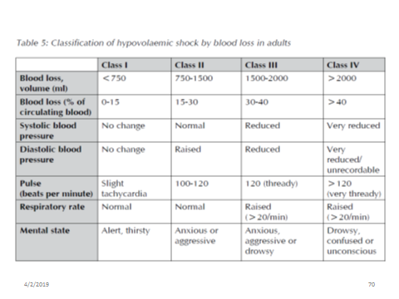

Slide 81
Investigations
CBC+BG &Rh
Coagulation tests
Liver function tests
Kidney function tests, I,e BUN: Cr
Endoscopy: best therapeautic and diagnostic
Notes:
A complete blood count (CBC) is necessary to assess the level of blood loss. CBC should be checked frequently(q4-6h) durin the first day.
The patient should be crossmatched for 2-6 units, based on the rate of active bleeding.
➢ The hemoglobin level should be monitored serially in order to follow the trend.
➢ An unstable Hb level may signify ongoing hemorrhage requiring further intervention.

Slide 82
Risk stratification
The elderly and patient with significant coexisting disease have a higher mortality following massive GI bleeding
Several risk stratification scores have been developed to assist in identification of patients who has high risk of mortality (require close monitoring ) and rebleeding
Rockhall and glascow-blachford scoring systems are commonly utilized .

Slide 83
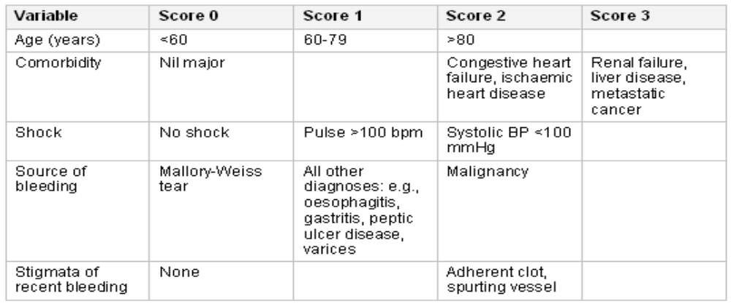
Rockhall risk score

Slide 84
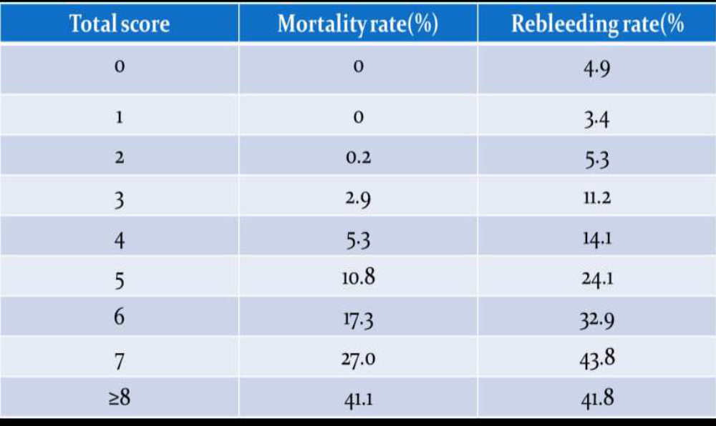
Low risk
Intermediate rsik
High risk
Notes:
If risk score <3=low risk, if 3-6=intermediate risk and if > 8 =high risk

Slide 85
Management
About 70-80% of bleeding stops spontaneously
Initial evaluation should focus on stabilizing the patient and rapid assessment of the magnitude haemorrhage
  <20% of BV- Postural changes in BP & pulse
  20–30% of BV - Tachycardia (>100 beats/min) and a reduced pulse pressure
  >40% of BV - impairment of conscious level, cool, clammy peripheries, & systolic BP less than 90 mm Hg
Identify and manage cause of bleeding

Slide 86
Should be managed by ABC system, “priority for C”
Aggressive volume replacement with target SBP>100mmHg
Signs of shock despite volume replacement (crystalloid 2L) signifies volume loss of 40% . Thus require transfusion.
Monitor response to resuscitation frequently (HR, BP, urine output, level of consciousness, peripheral temperature)

Slide 87
Endoscopy
  Once resuscitated the patient
  Can be performed in elective manner in stable patients (with in 24 hrs)
  Aids diagnosis and determines early discharge of the patients
  Believed to improve the prognosis in unstable patients despite resuscitation

Slide 88
Haemostasis
  Ideally all patients who show active bleeding, or who have endoscopic stigmata of recent haemorrhage, should receive endoscopic therapy comprising of
  Adrenaline 1:10, 000 injected into four quadrants
  Heat application by means of multipolar heater probes
  Applying vascular clips to bleeding vessels endoscopically
Notes:
The heater probe has a thermocouple at the tip of the probe and can heat up instantaneously to achieve tissue coagulation. Multipolar probes achieve haemostasis by heating the tissue with electricity that passes through the tip of the probe rapidly from positive and negative electrodes.

Slide 89
Proton Pump Inhibitors: blunts mucosal antifibrinolytic activity. Thus, facilitates platelet aggregation
PPIs are Recommended for empirical treatment of UGIB prior to endoscopy.
Tranexamic acid may reduce the need for surgical intervention but not as a routine therapy prior to endoscopy
Terlipressin: a synthetic analog to vasoppressin.
  Decreases portal blood flow I,e. variceal bleding

Slide 90
Vasopressin: splanchnic vasoconstriction, decreases variceal pressure
Beta blockers- known to decrease portal pressure
Statins: splanchnic vasoconstriction and decreased portal blood flow

Slide 91
Surgery
Surgery reserved for bleeding which is not amenable to endoscopic therapy
Indications:
  Hemodynamic instability despite vigorous resuscitation (>6 U) transfusion
  Failure of endoscopic techniques to arrest hemorrhage
  Rebleed after initial stabilization (with up to two attempts at obtaining endoscopic hemostasis)
  Shock associated with recurrent hemorrhage
  Continued slow bleeding with a transfusion requirement >3 U /day

Slide 92
Anesthetic considerations
Most gastric hemorrhages are managed either conservatively or by therapeutic endoscopic intervention
In persistent or severe hemorrhage that requires surgery, then the involvement of an anesthetist is inevitable.
Major anesthetic Challenges
  Co-morbidity
  Old age
  Hemodynamic instability/shock
  Anemia
  Fluid and electrolyte disturbances
  Full stomach

Slide 93
The primary anesthetic goal in a patient compromised by severe gastric hemorrhage is to facilitate rapid surgical access in order to isolate the site of bleeding, while simultaneously resuscitating the patient and maintaining tissue oxygenation and perfusion
The rate of blood loss will dictate the time available for resuscitation.
It may be pertinent to admit the patient preoperatively to a critical care facility for assessment, monitoring, and preoptimization.
Notes:
For those patients and others with signs of refractory shock (e.g. lactate>4mmol litre1, pH<7.3 after resuscitation), admission to a critical care area should be considered early.

Slide 94
The etiology of the hemorrhage should be considered. Variceal bleeding is invariably associated with hepatic impairment, which will influence the conduct of anesthesia
Fluid resuscitation starts with rapid infusion of isotonic crystalloid solution.
In patients non-responsive to crystalloids, resuscitation is continued using blood and FFP if INR>1.5 of normal.

Slide 95
Whole blood is of choice in massive blood loss other wise packed RBC is more preferable
In extreme circumstances, O negative blood may be required initially.
Platelet transfusion should be given to patients with platelet count<50,000 and considered in those actively bleeding while established on anti-platelet therapy such as clopidogrel.
Patients actively bleeding while taking warfarin therapy should receive Prothrombin complex concentrate (PCC).

Slide 96
The use of colloids in resuscitation is not advocated given concerns over kidney injury, worsened coagulopathy, risk of anaphylaxis, and a lack of benefit over crystalloids

Slide 97
Initial anesthetic management would the same to any bleeding patient
NG tube and aspiration
High flow 100% oxygen via non rebreathing circuit and volume replacement with double line large bore IV line should be commenced
Early elective tracheal intubation should be considered in those with ongoing haematemesis and altered mental or respiratory status to minimize the risk of aspiration, whilst aiding endoscopy.

Slide 98
Anesthetic induction will require a rapid sequence technique in a slightly head up position, if tolerated.
Invasive arterial monitoring allows closer monitoring of haemodynamic status and facilitates frequent blood gas and laboratory samples to be taken.
Central venous line insertion, provided coagulation is not deranged, gives secure i.v. access and allows central venous pressure measurements to be taken.

Slide 99
Flow guided methods of monitoring such as LidCO or oesophageal pressure monitoring give a more accurate guide to volume status.
A urine output should be monitored at higher level
Body temperature should be carefully monitored because shocked patients easily become hypothermic.
Rooms and all IV infusions need to be warmed as much as possible.

Slide 100
Having achieved surgical hemostasis, the circulating volume and hemoglobin can then be optimized in the immediate postoperative period
Generally patients who are stable & no recent hemorrhage on endoscopy can be discharged within 24 hours
Patients age, endoscopic diagnosis, comorbidity & presence or absence of shock should be considered
Generally patients with rockall’s score>8 are considered high risk of death and rockall’s score<3 have excellent prognosis

Slide 101
Thank you

